Slide 1
Personal Portfolio Website
And
Image Slider
By
BISWAJEET POLLAI

Slide 2
INTRODUCTION
My name is Biswajeet Pollai and I joined this program one month ago.
I have worked on two projects, and I will explain these two projects in my report, one by one.
My first project name is Personal Portfolio Website and my another project name is Image Slider.

Slide 3
Personal Portfolio Website

Slide 4
AIM OF THE PROJECT
Designing a visually appealing and user-friendly website layout that reflects the individual's personality, creativity, and professionalism.
Providing sections to highlight the individual's skills, expertise, qualifications, and certifications, effectively demonstrating their competence in relevant areas.
Integrating the individual's resume or curriculum vitae (CV) into the website, ensuring that visitors can easily access detailed information about the individual's education, work history, achievements, and professional affiliations.
Ensuring that the website is responsive and accessible across various devices and screen sizes, providing a seamless browsing experience for visitors accessing the site from desktops, laptops, tablets, or smartphones.
Incorporating elements of personal branding, such as a unique logo, color scheme, typography, and storytelling, to create a memorable and distinctive online identity for the individual.

Slide 5
OBJECTIVE OF THIS PROJECT
To provide a centralized digital space where the individual can showcase their professional identity, including skills, experiences, and accomplishments, to potential employers, clients, and collaborators.
To effectively highlight the individual's achievements, projects, and works through a visually appealing portfolio section, providing detailed insights into their capabilities and expertise.
To facilitate networking opportunities by including contact information, social media links, and interactive features that allow visitors to connect with the individual for potential collaborations, job opportunities, or inquiries.
To establish a strong personal brand by incorporating elements of branding, such as a unique logo, color scheme, typography, and storytelling, that effectively convey the individual's personality, values, and professional identity.

Slide 6
SOFTWARE USED
Front End: HTML5, CSS
Database type: Google Sheets
Back End: Java Script
Technical Details
Frontend: Developed using HTML, CSS, and JavaScript to provide a responsive and intuitive user experience.
Backend: Utilizes Google Sheets, allowing for real-time data synchronization and storage.

Slide 7
USES INSTRUCTIONS
Navigation:
Use the navigation menu or buttons provided on the website to explore different sections such as Home, About Me, Portfolio, Resume, Contact, etc.
These sections are typically accessible through clearly labeled tabs or links.
Home Page:
Start by visiting the home page, which often serves as an introduction to the individual and their portfolio.
Here, you may find a brief overview, welcome message, or introductory video showcasing the individual's personality and skills.
About Me:
Navigate to the "About Me" section to learn more about the individual behind the portfolio.
This section may include information about their background, education, professional experience, skills, interests, and aspirations.

Slide 8
Project Showcase:
Explore the portfolio section to view the individual's showcased projects, works, case studies, or achievements.
Each item in the portfolio is typically accompanied by a description, images, videos, or links providing additional details and context.
Resume/CV:
Access the resume or curriculum vitae (CV) section to review the individual's detailed professional history, including education, work experience, certifications, awards, and accomplishments.
You may find downloadable PDF versions or interactive formats for viewing the resume.
Contact Information:
Locate the contact section to find the individual's contact information, including email address, phone number, and links to their social media profiles (e.g., LinkedIn, Twitter). Use this information to reach out for collaborations, job opportunities, or inquiries.

Slide 9
Social Media Integration:
Take advantage of any social media integration features to connect with the individual on various social networking platforms. Follow, connect, or engage with them to stay updated on their latest projects, updates, and activities.
Responsive Design:
The website is designed to be responsive, meaning it adapts and optimizes its layout for various devices such as desktops, laptops, tablets, and smartphones. Enjoy a seamless browsing experience regardless of the device you're using.

Slide 10
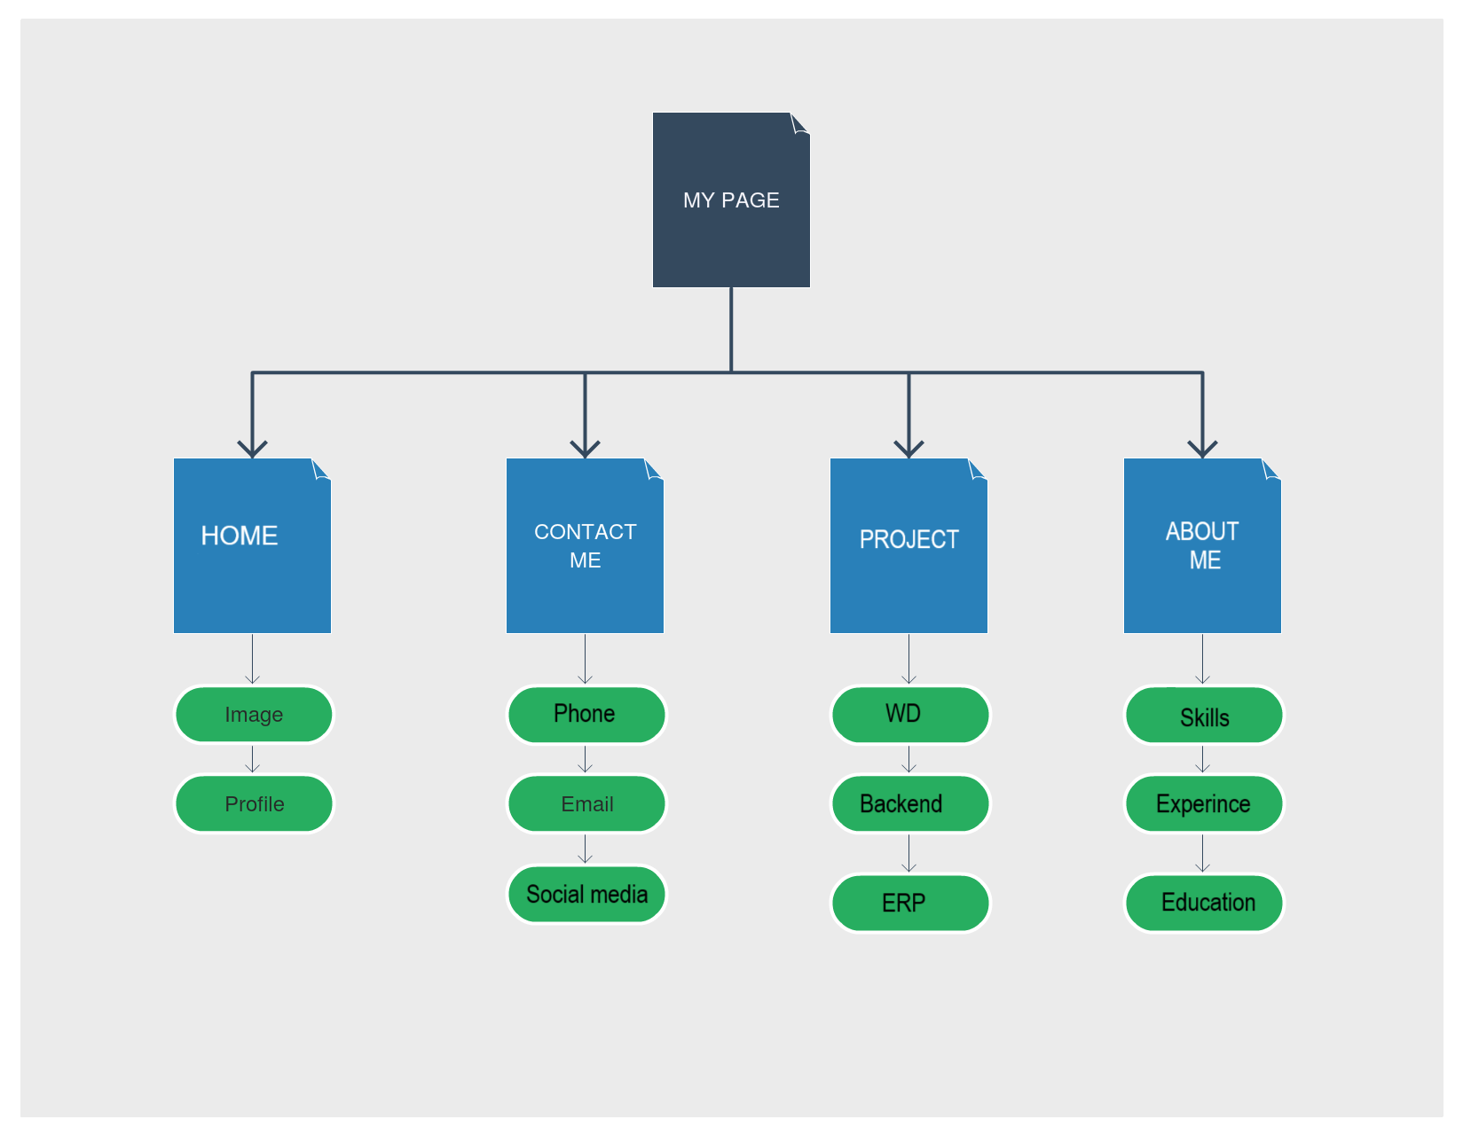
ARCHITECTURE DIAGRAMS

Slide 11
BENEFITS
Showcase Your Work:
It provides a centralized platform to display your projects, achievements, and skills. This is particularly useful for freelancers, artists, designers, and other creative professionals to exhibit their best work.
Professional Presence:
Having a polished and professional website enhances your online presence.
It acts as a digital resume, making it easier for potential clients or employers to find and learn more about you.
Accessibility:
Unlike physical portfolios or resumes, which are limited by geography and format, a website is accessible to anyone with an internet connection. This means your work can reach a much wider audience, potentially leading to more opportunities.
And too many benefits are there.

Slide 12
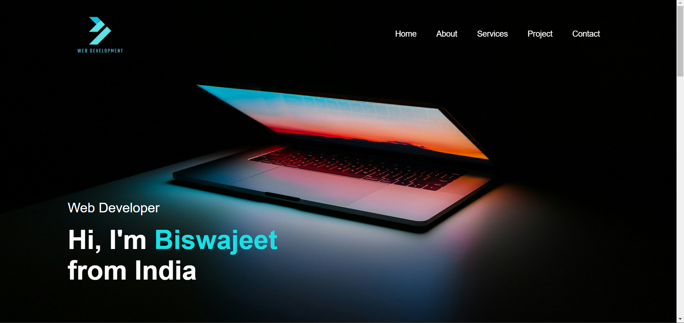
SCREENSHOTS

Slide 13
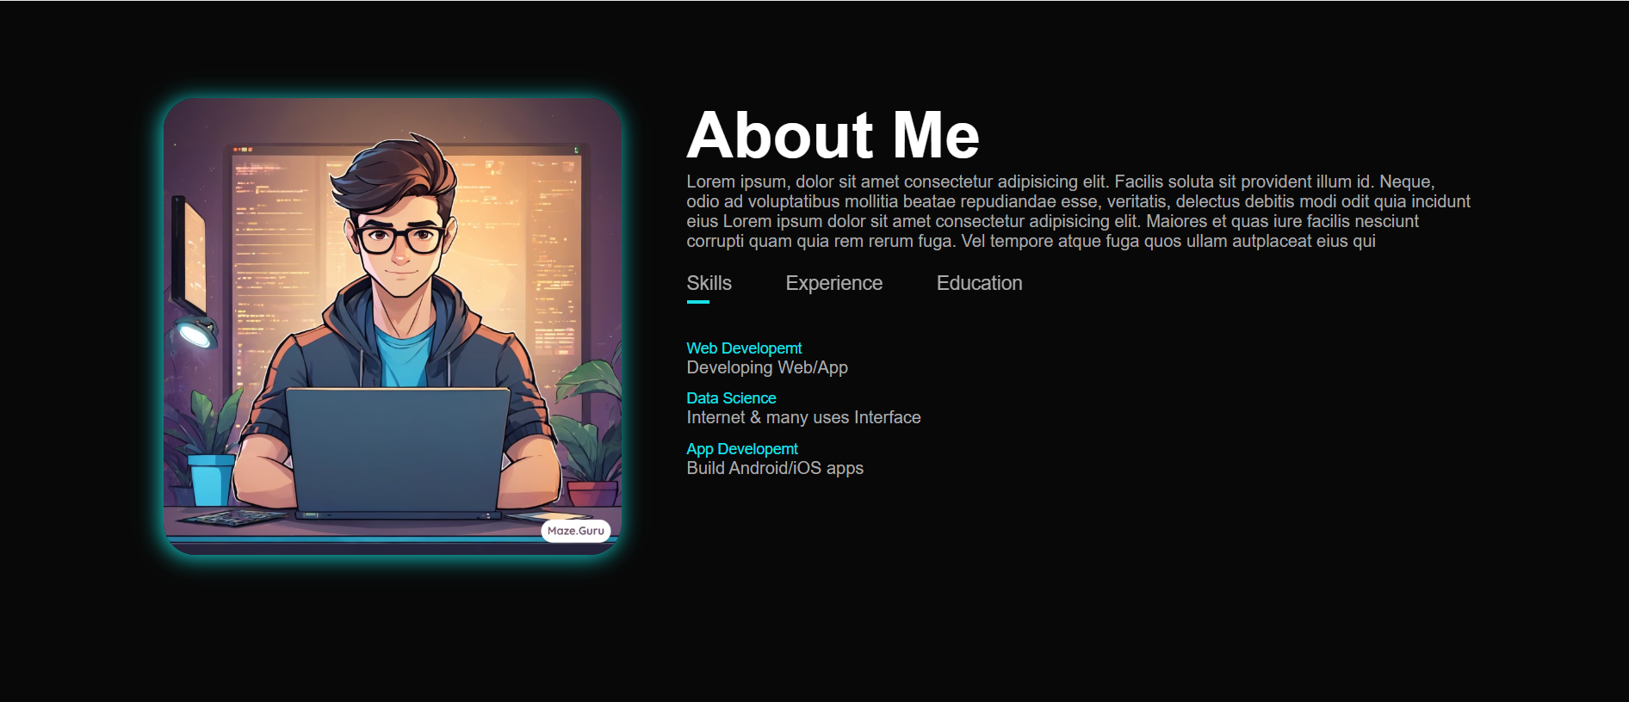
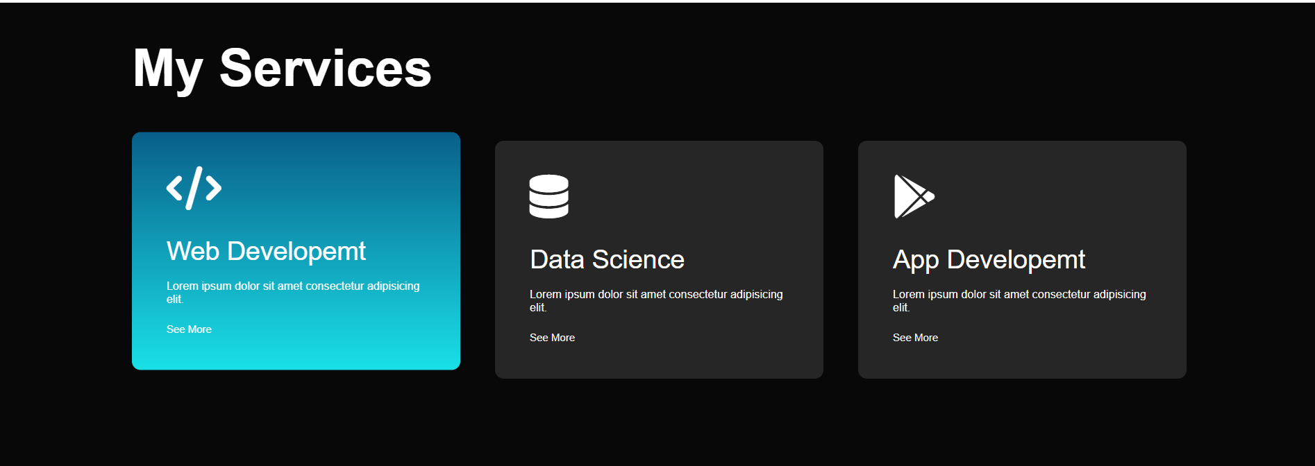
SCREENSHOTS

Slide 14
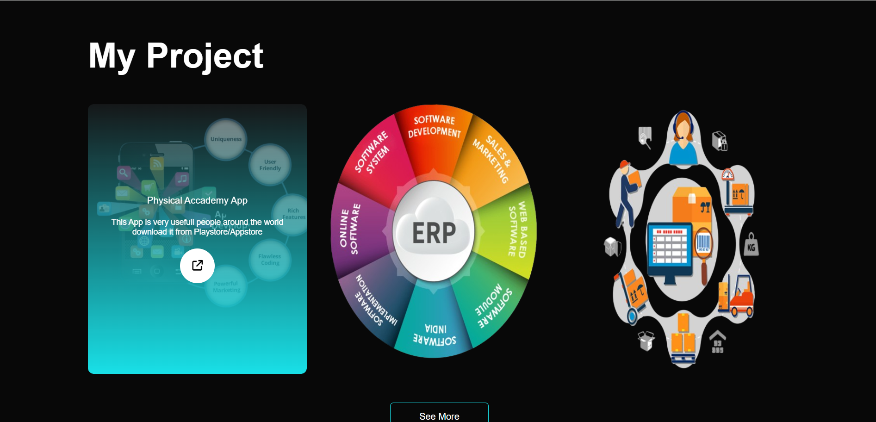
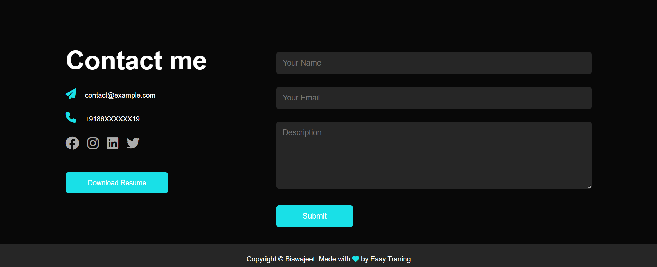
SCREENSHOTS

Slide 15
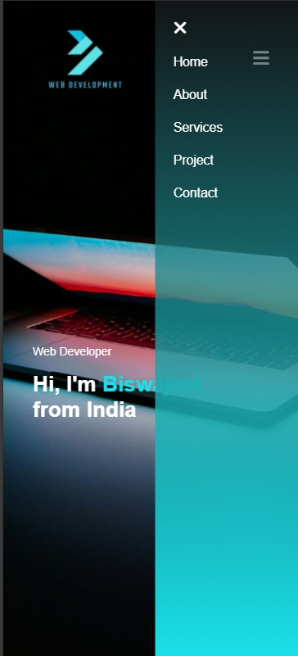
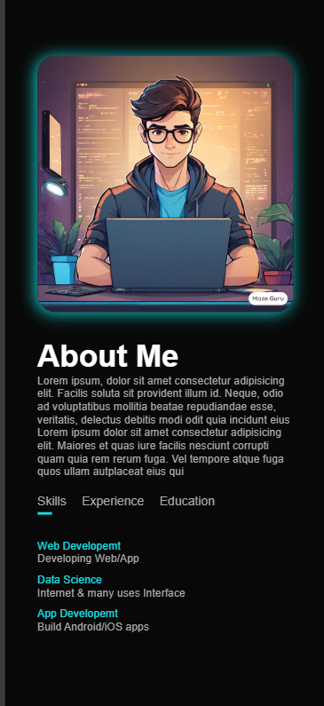
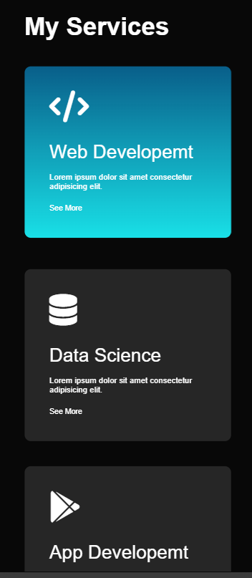
SCREENSHOTS IN MOBILE

Slide 16
CONCLUSION
In conclusion, a personal portfolio website offers numerous benefits for professionals across various industries. It serves as a dynamic platform to showcase your work, skills, and achievements, allowing you to create a compelling narrative about your expertise and experience.
With complete control over design and content, you can tailor your website to reflect your personal brand and style, enhancing your professional presence online. Furthermore, a well-optimized website can increase your visibility, attract new opportunities, and facilitate networking with peers and potential clients. By demonstrating your technical skills and commitment to professionalism, a personal portfolio website helps to build trust and credibility in your field. Ultimately, investing in a personal portfolio website is a valuable step towards advancing your career or business objectives in today's digital age.
My GitHub repo : https://github.com/biswajeetCodes/Personal-Portfolio-Website

Slide 17
IMAGE SLIDER

Slide 18
AIM OF THE PROJECT
The aim of the "Image Slider" project is to create a dynamic and visually engaging interface that allows users to view a collection of images in a seamless and interactive manner. This project aims to develop a user-friendly image slider component that can be easily integrated into websites or applications, enhancing the overall user experience.
The primary objectives include designing an intuitive navigation system, implementing smooth transitions between images, optimizing performance for various devices and screen sizes, and providing customization options for developers to tailor the slider to their specific needs. Through this project, we aim to deliver a versatile and efficient image slider solution that meets the demands of modern web development and enhances the presentation of visual content online.

Slide 19
The image slider should showcase images in an aesthetically pleasing way, possibly including transitions, animations, or other effects to enhance the visual experience.
OBJECTIVE OF THIS PROJECT
The primary goal is to engage users by presenting them with visually appealing content in a convenient and interactive format.
The image slider should showcase image in an aesthetically pleasing way, possibly including transitions, animations, or other effects to enhance the visual experience.
It should be easy for users to navigate through the images, whether by clicking buttons, swiping on touch screens, or utilizing other intuitive controls..
The slider should be responsive and work well on various devices and screen sizes, including desktops, tablets, and mobile phones.
Ensuring that the slider is accessible to users with disabilities, including support for keyboard navigation and screen reader compatibility.

Slide 20
SOFTWARE USED
Front End: HTML5, CSS
Back End: Java Script
Technical Details
Frontend: Developed using HTML, CSS, and JavaScript to provide a responsive and intuitive user experience.

Slide 21
BENEFITS
Visual Appeal:
Image sliders provide a visually engaging way to showcase content, products, or images on a website. They can attract users' attention and make the website more aesthetically pleasing.
Space Optimization:
Sliders allow you to display multiple images or pieces of content within a confined space on the webpage. This is particularly useful for websites with limited space or where you want to avoid cluttering the layout.
Mobile Optimization:
Many image sliders are designed to be responsive, meaning they adapt to different screen sizes and devices. This ensures a consistent user experience across desktops, tablets, and smartphones.

Slide 22
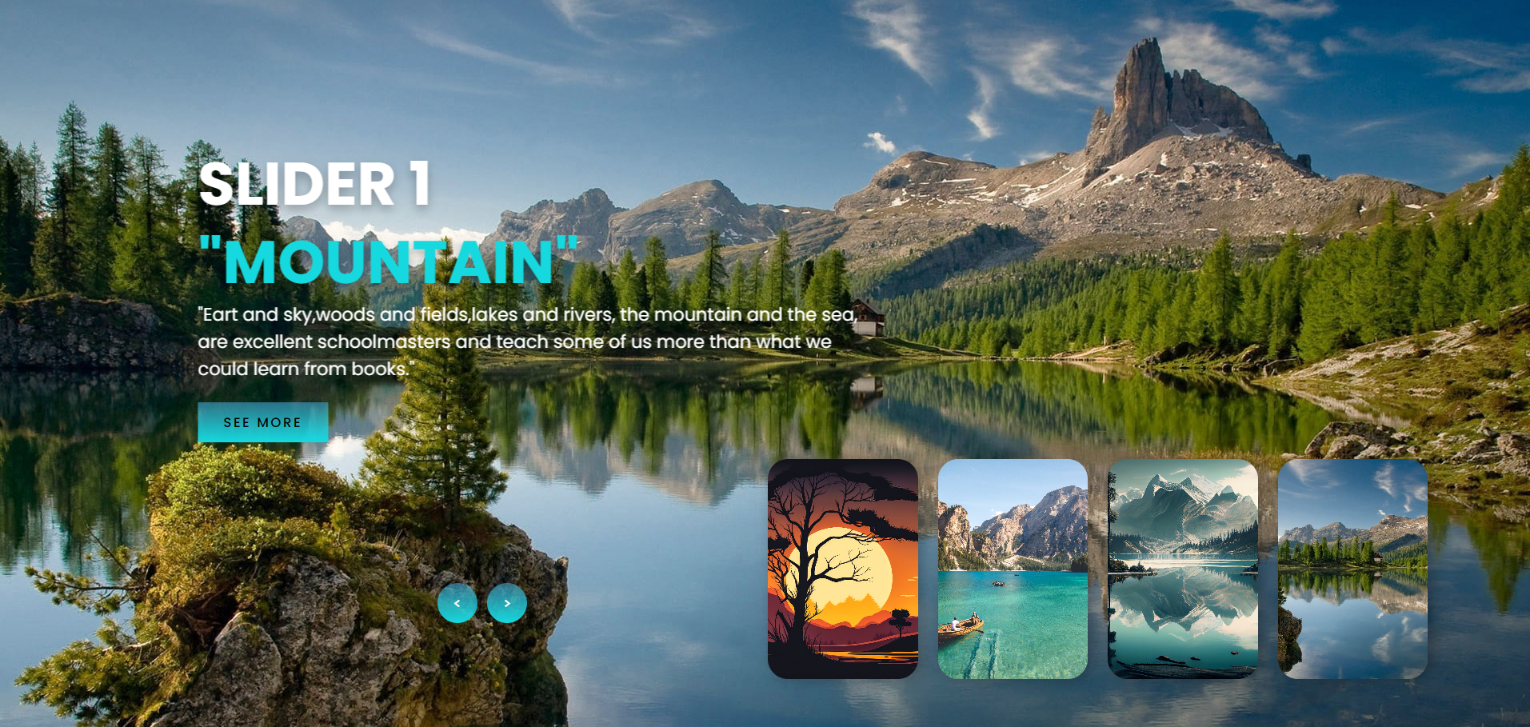
SCREENSHOTS

Slide 23
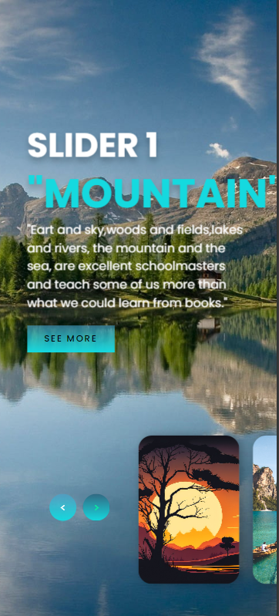
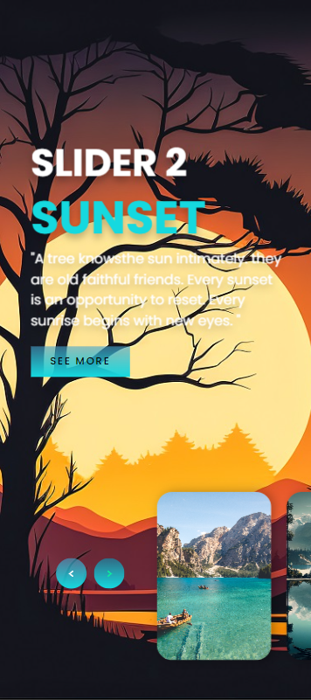
SCREENSHOTS IN MOBILE

Slide 24
CONCLUSION
Enhanced Visual Appeal: The image slider adds visual interest to the website, capturing users' attention and improving overall aesthetics.
Optimized Space Usage: By displaying multiple images within a confined space, the slider optimizes layout design and prevents clutter on the webpage.
Improved User Engagement: With interactive navigation controls, users can easily explore the slider's content, leading to increased engagement and interaction with the website.
Promotion and Highlighting: The slider provides a platform for promoting products, offers, or important messages, effectively highlighting key aspects of the website or business.
The slider is designed to be responsive, ensuring a seamless user experience across various devices and screen.
My GitHub repo : https://github.com/biswajeetCodes/Image-Slider

